Slide 1

The Evolution of the NBA
Presented by: Gili Dror

Slide 2
Objective
In what ways has the NBA changed over time?
  Are players entering the NBA taller, faster, bulkier, more agile, and higher leapers than the players who entered in previous years?
  Have teams been scoring more and shooting more three pointers, free throws, and field goals in general?

Slide 3
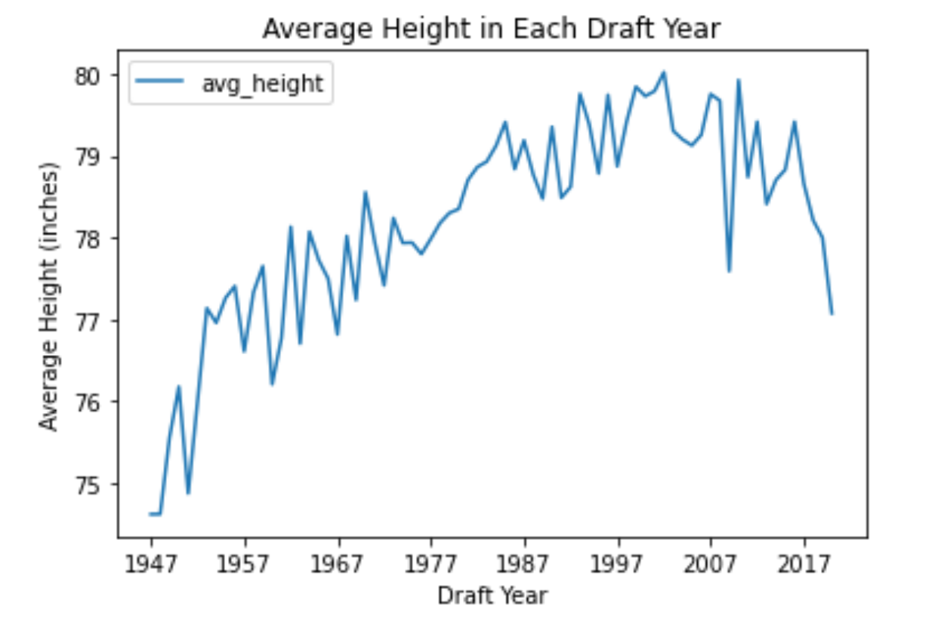
Players’ Height
Average height of incoming players has an overall upwards trend until around 1997 and then starts to slightly decline

Slide 4
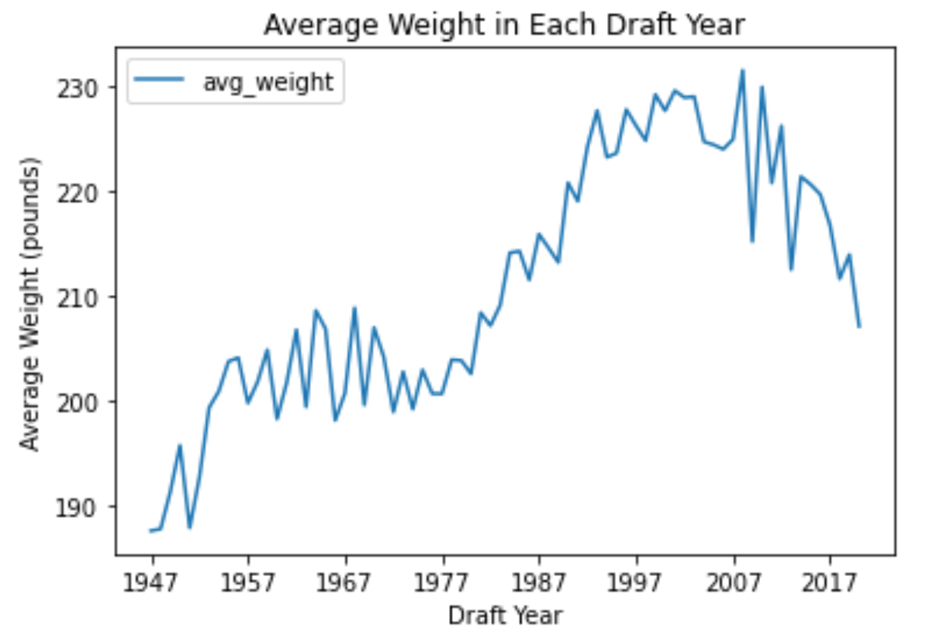
Players’ Weight
Average weight of incoming players has an overall upwards tend except from around 1957-1977 and around 2007 to now

Slide 5
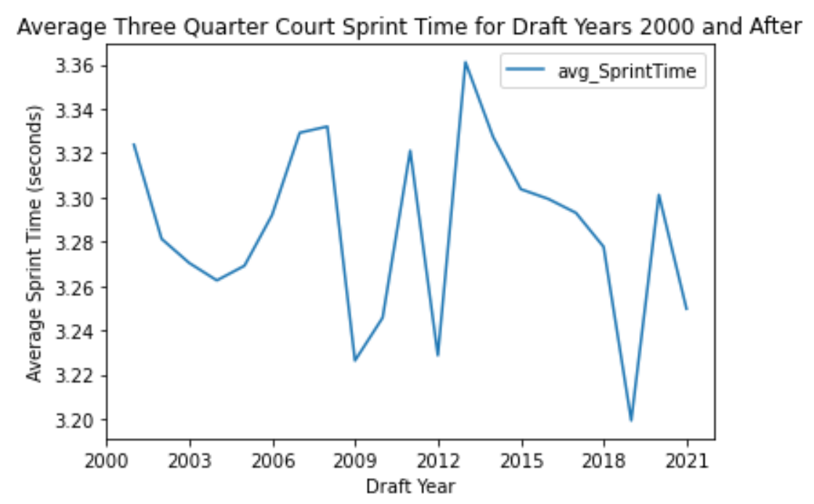
Players’ Speed
There doesn’t seem to be an obvious direction in trend for the average sprint time

Slide 6
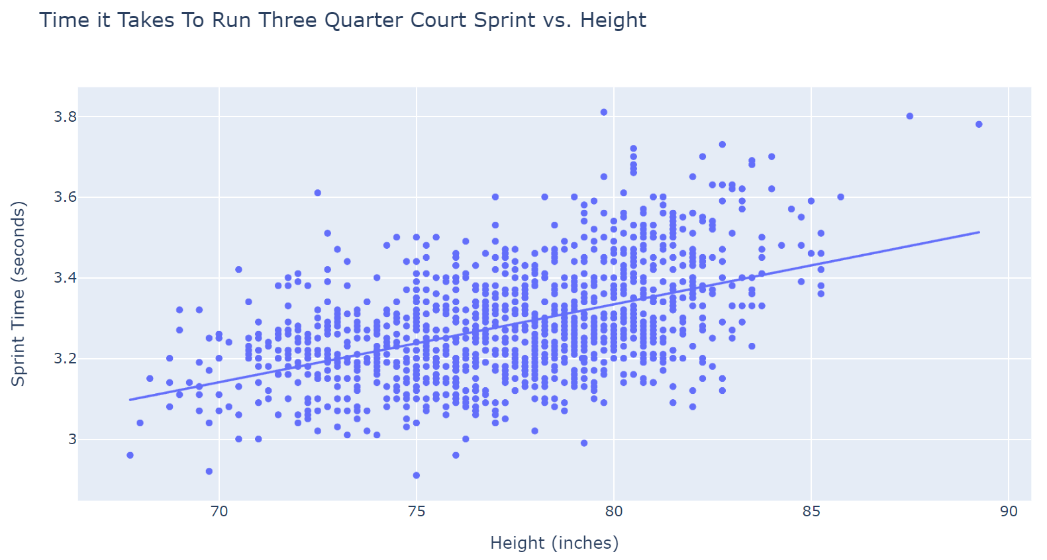
Speed and Height
A strong positive relationship between height and sprint time

Slide 7
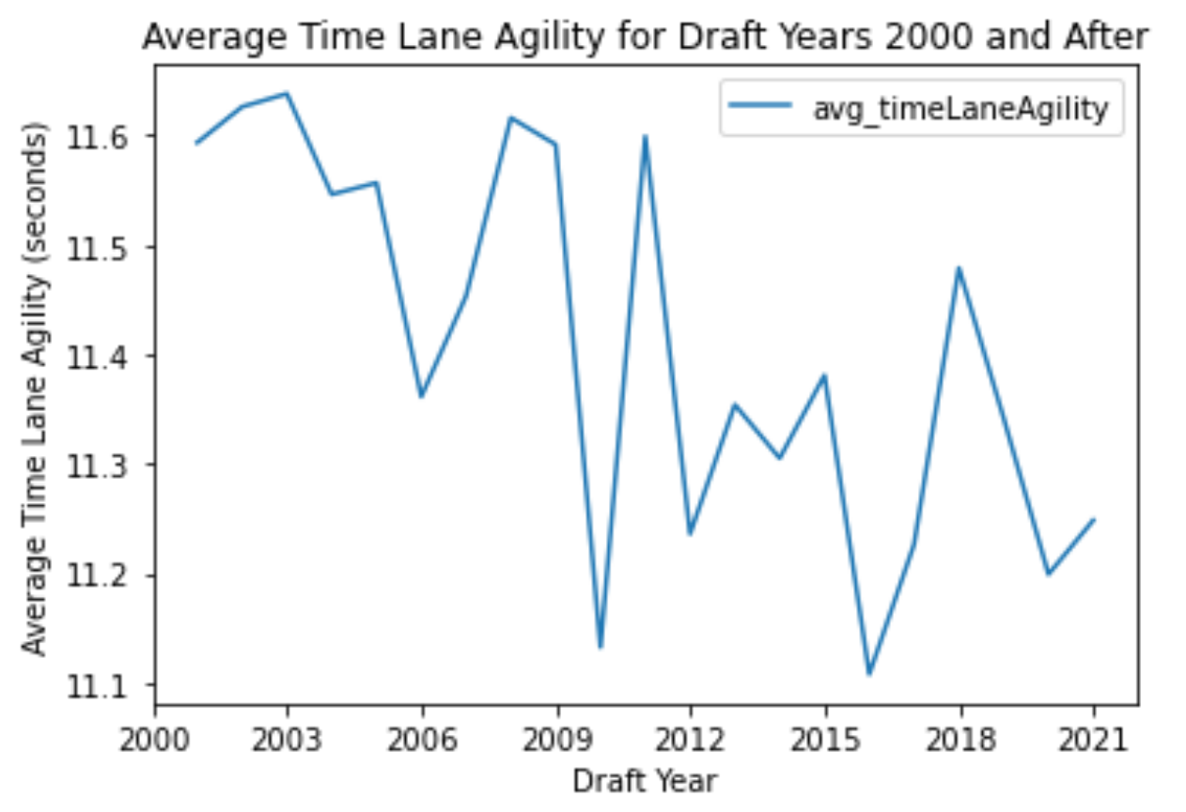
Players’ Agility
There seems to be a slight decrease overall in the average time lane agility
This implies that player’s seems to have had an overall increase over the years

Slide 8
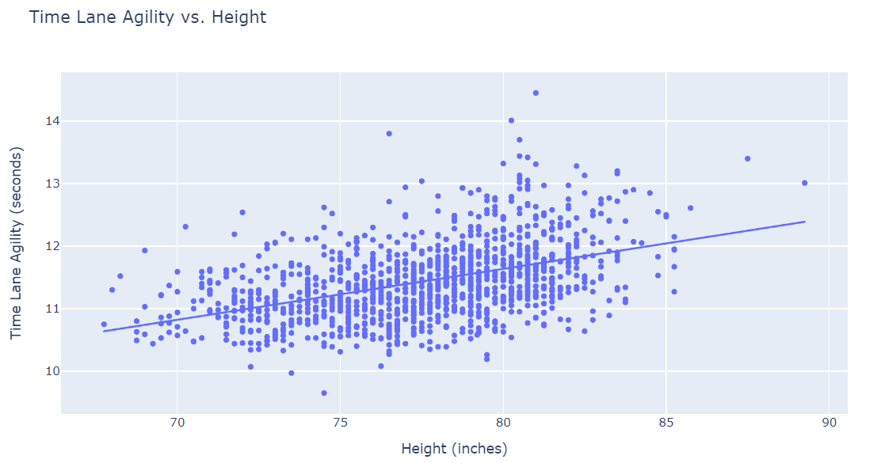
Agility and Height
There is a slightly positive relationship between time lane agility and height.

Slide 9
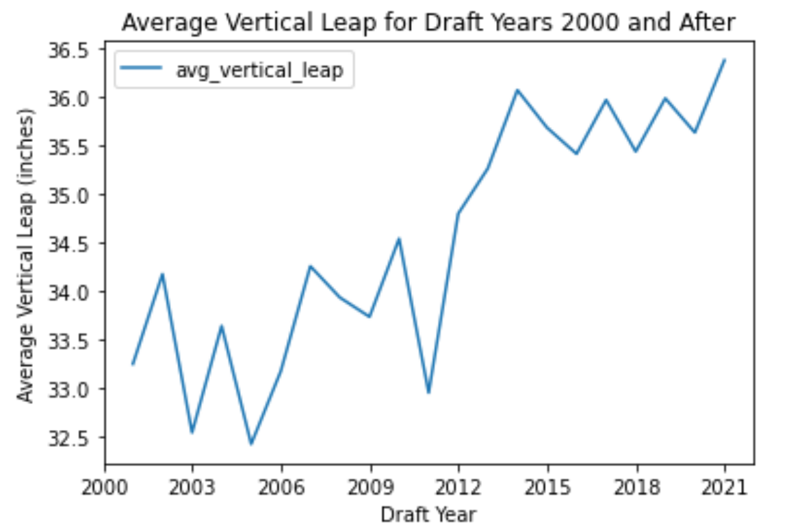
Players’ Vertical Leap
The average Vertical leap increases rapidly at around 2012 until 2015
From 2015 onwards the average vertical leap stays about the same

Slide 10
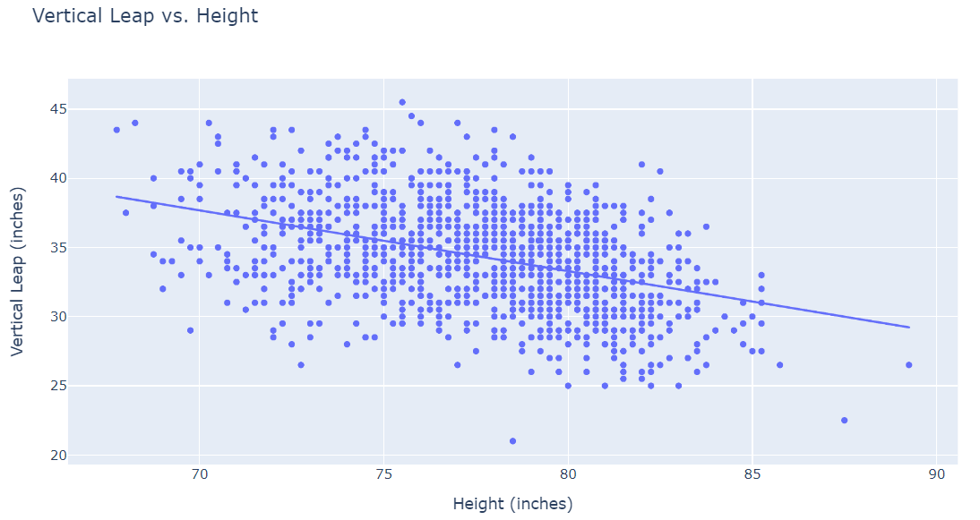
Vertical Leap and Height
There is an overall negative correlation between vertical leap and height

Slide 11
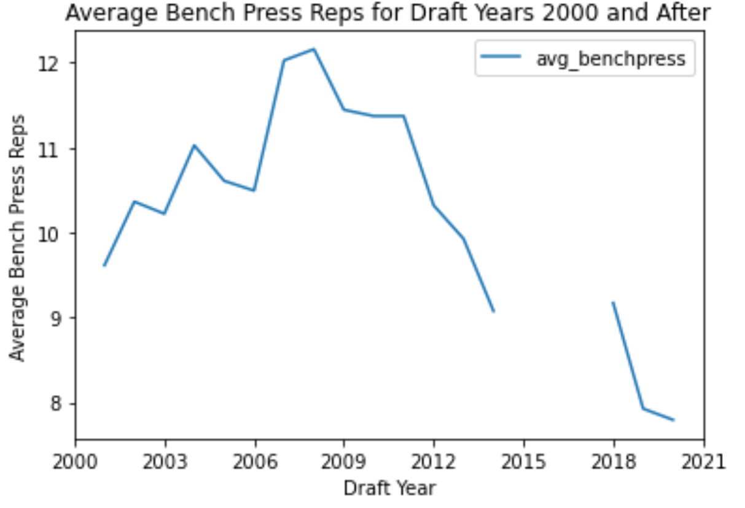
Players’ Strength
The average bench press reps increased until 2009 and from 2009 onwards rapidly decreased

Slide 12
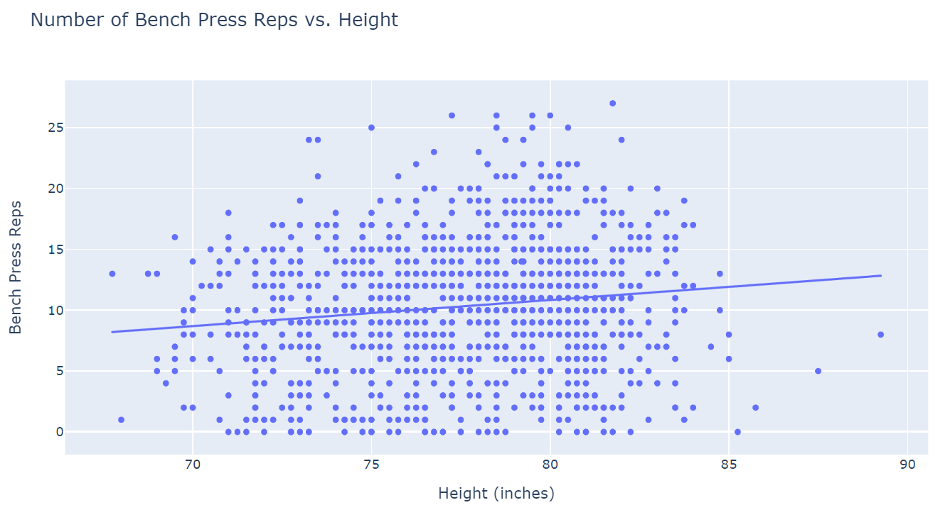
Strength and Height
There is no seeming correlation between height and bench press reps

Slide 13
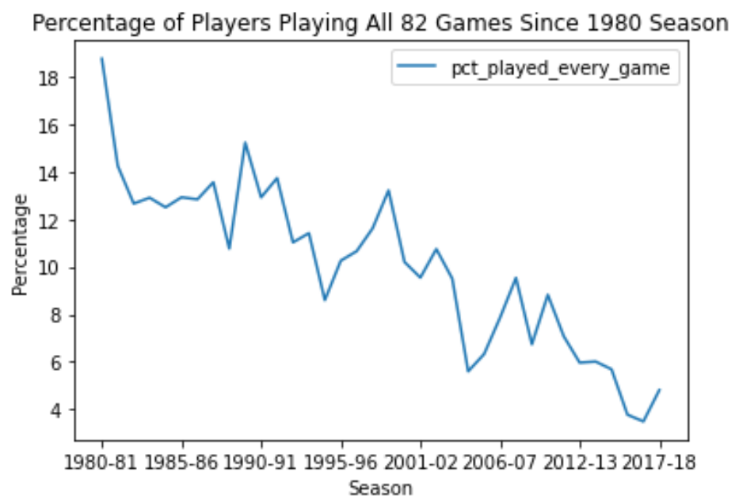
Percentage of Games Players Played
There is a downwards trend over the years in the percentage of players that are playing all 82 games of a season

Slide 14
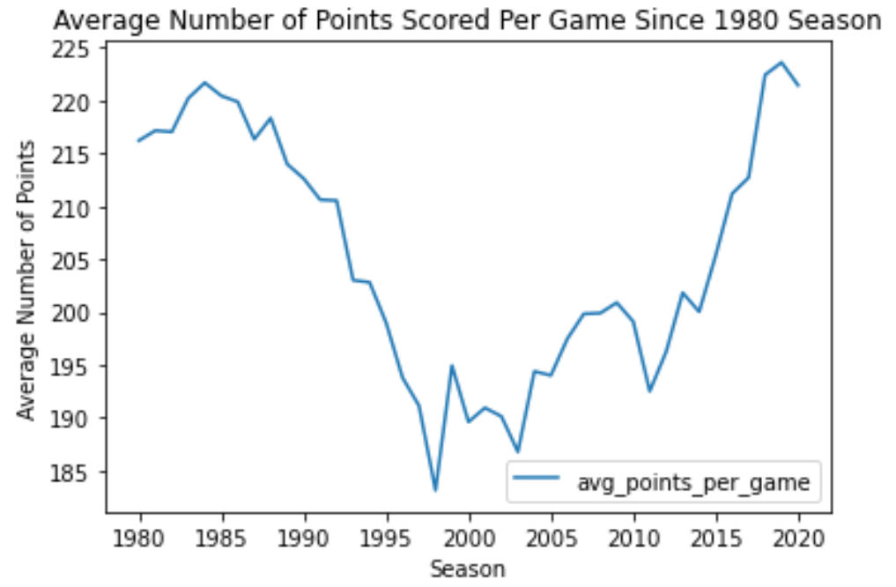
Points Per Game
1980s and 2010s seem to have a relatively high amount of average point scored per game compared to the 1990s and 2000s

Slide 15
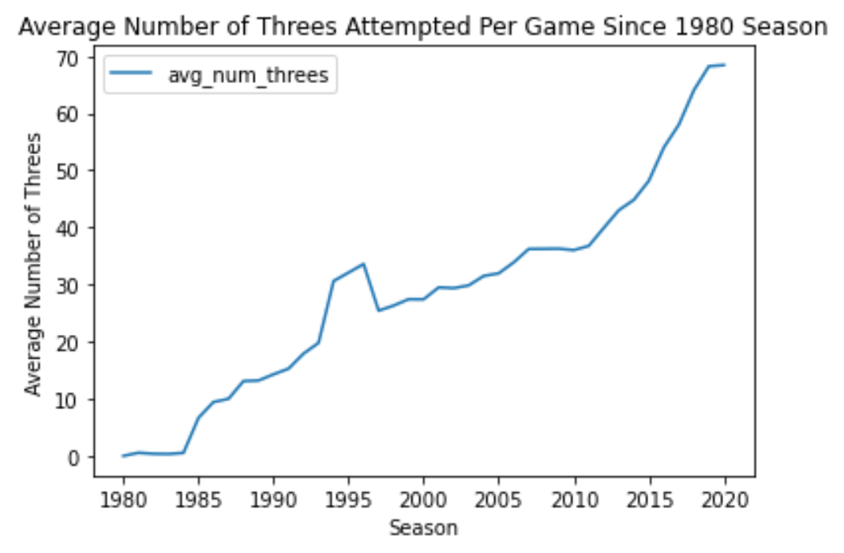
Three Point Shots
There is an overall increase in the average amount of three pointers attempted per game from the 1980s to 2020

Slide 16
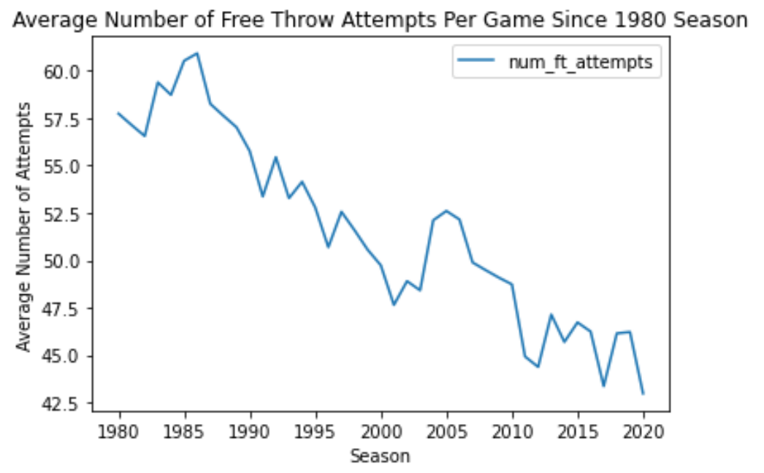
Free Throw Shots
The average number of Free Throws attempted per game has declined since the 1980s

Slide 17
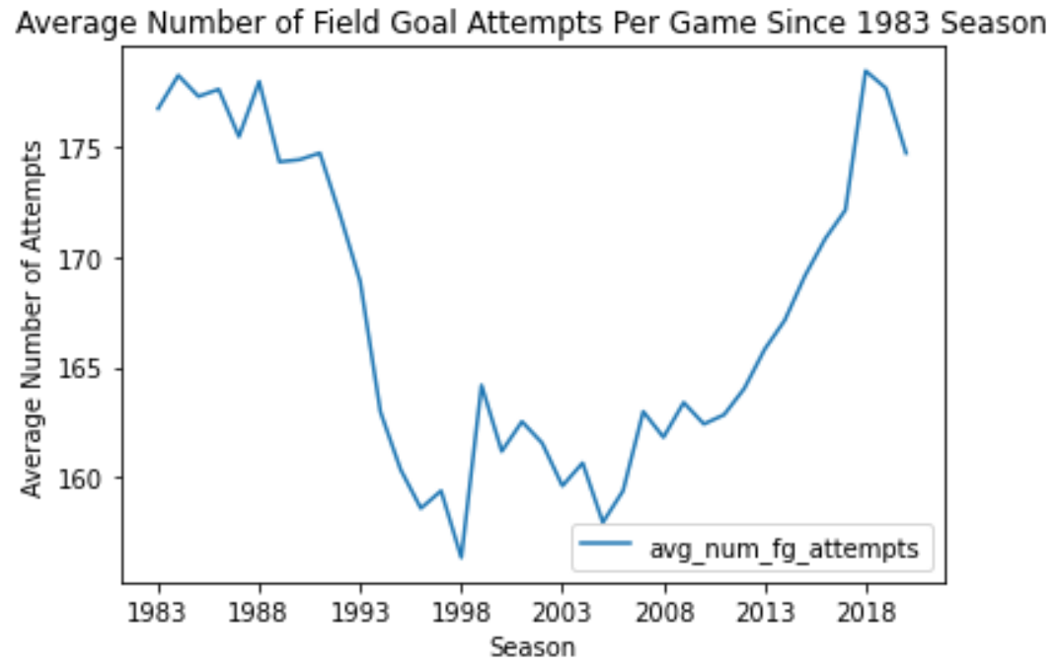
Field Goal Attempts
The number of field goal attempts remained relatively constant but was higher in the 1980s and 2010s

Slide 18
Big Takeaways
Players are taller and heavier in recent decades compared to the 1970s and prior.
Players of the 2010s are more agile and higher jumpers than in the 2000s.
NBA games have had a decline in free throw attempts, but a rise in three pointer attempts
There has been a decline in the percentage of players that play a full seasons (all 82 games).

Slide 19
Appendix

Slide 20
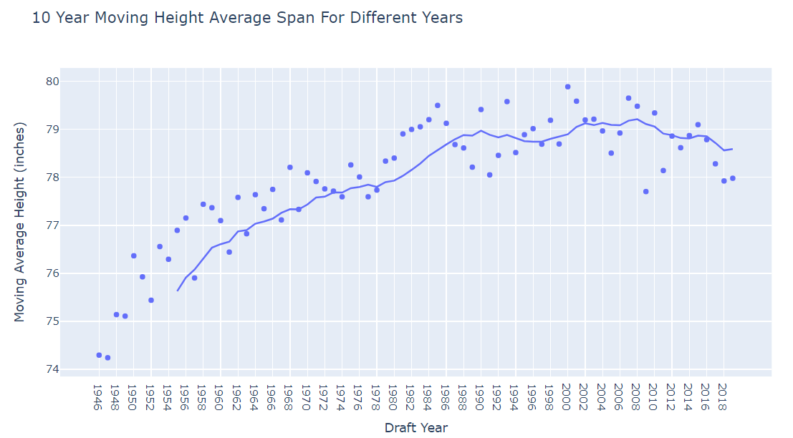
Moving Average of Heights

Slide 21
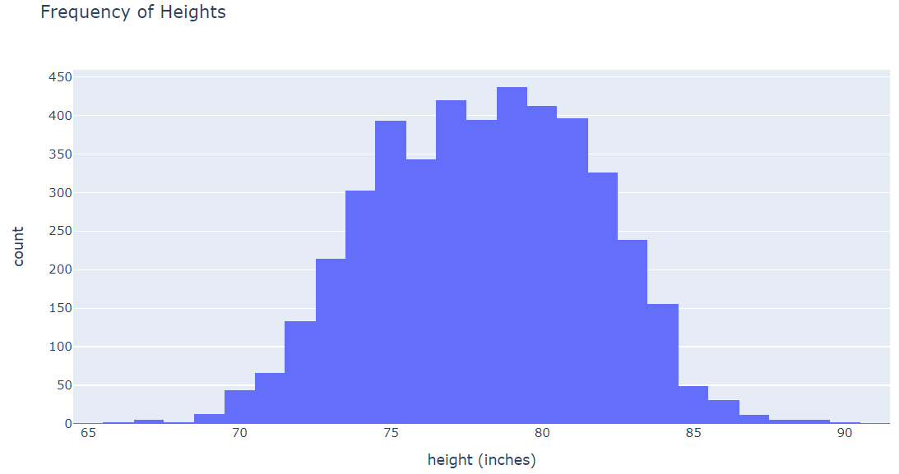
Distribution of Players’ Heights
Most players are approximately 75 to 80 inches
(between 1.905 and 2.032 inches)

Slide 22
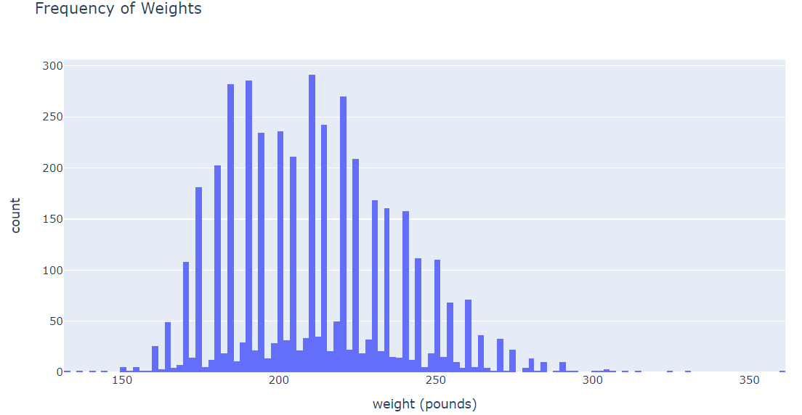
Distribution of Players’ Weights
Most players seem to way between 200 and 250 lbs.

Slide 23
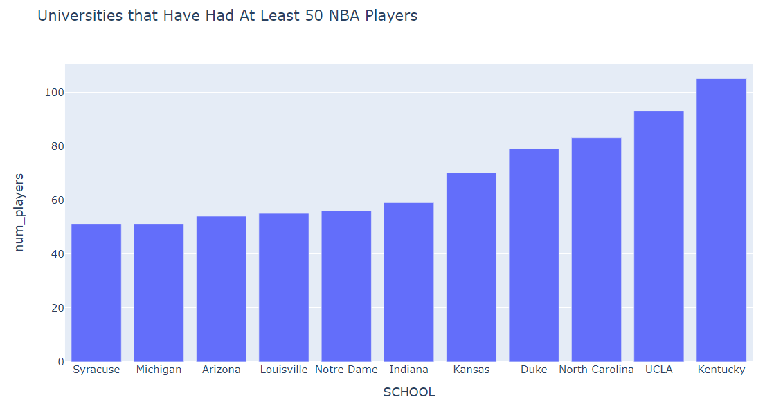
Universities NBA Players Come From

